Slide 1
Functional Programming putStrLn “Haskell is Fun!”
Markos Vassilis, Mediterranean College, 2024 - 2025, Spring
Week 14

Slide 2
No Side Effects?

Slide 3
Why Haskell Supports I/O?
(A) We have said that Haskell implements Functional Programming (FP).
(B) We have also said that in FP functions have no side–effects, i.e., they just have some input and return some output without modifying anything in the universe or acting in any other way.
(C)Printing on screen while executing a function is a side effect.
So, how can (A), (B), and © be true at the same time?
Some options:
Haskell is magic.
Not all three hold true at the same time.
All three hold true and there is something we have to explain…

Slide 4
Haskell + IO ()
Haskell has its own way to deal with impurity, i.e., things that might not provide the same output on the same input:
I/O
Randomness
If it happens that you have a PhD in Category Theory, then you are well aware of Monads.
In case you are not, Monads are roughly like “close worlds” in which you can apply functions that return values in this closed world onto stuff that does also belongs to that world.
For more: https://www.adit.io/posts/2013-04-17-functors,_applicatives,_and_monads_in_pictures.html

Slide 5
Countdown

Slide 6
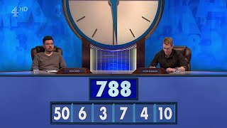
Let Us Watch Some TV Shows First…

Slide 7
What Is “The Countdown”?
Countdown is a British game show involving word and mathematical tasks.
First aired: 1972.
90 regular series, 8443 regular episodes.
The players contest in three types of tasks:
Making the longest possible word from 9 random letters.
Reaching a target positive integer using 6 random positive integers through arithmetic.
Solving a nine–letter anagram.
Source: https://en.wikipedia.org/wiki/Countdown_(game_show)

Slide 8
Your Turn!
Consider the following six numbers:
1, 3, 7, 10, 25, 50.
Also consider this target number: 765
Try to reach this number using the four common arithmetic operations, +, –, *, /, and all of the above six numbers at most once!
Optionally, do so in under 30 seconds.
How many solutions are there?
One solution: (1+50)*(25–10)

Slide 9
Your Turn!
Consider again the following six numbers:
1, 3, 7, 10, 25, 50.
Also consider this target number: 831
Try to reach this number using the four common arithmetic operations, +, –, *, /, and all of the above six numbers at most once!
Optionally, do so in under 30 seconds.
How many solutions are there?
There is no solution in this case

Slide 10
How To Solve This Problem?
While in the actual TV show people solve this problem using their bare brain capacity, we can take advantage of our PCs and programming, in particular…
Sounds like cheating? Well, it is, but we are computer scientists, not TV show participants!
So, how would you approach this problem?
Take some time to think of it:
Take some notes of your thoughts?
Write down your idea in pseudocode?
Write a draft Haskell script?
Write a short paper on “The Countdown”?
With Functional Programming, the sky's the limit!

Slide 11
Fun Time!

Slide 12
The Countdown Problem
To implement a fully working solution of the Countdown problem as discussed above, follow the instructions found at:
./labs/countdown_lab_01.pdf
Feel free to make any optimisations you see fit to make your solution run faster!

Slide 13
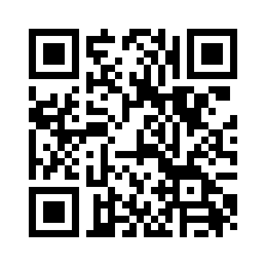
Any Questions
Don’t forget to fill in the questionnaire shown right!
Office hours: Tuesday: 09:00 —10:00, Glyfada, PC Lab Wednesday: 15:00 — 17:00, Pellinis, 203
https://forms.gle/YU1mjxjBjBf8hyvH7

